Slide 1


HCI Credit Score Prediction
Irfani Adri Maulana
Final Year Informatics Student
Virtual Internship Experience Program by Rakamin Academy
Data Scientist – Home Credit Indonesia
Score Credit Prediction using
Classification Machine Learning

Slide 2


Overview
Support Vector Machine
Logistic Regression
&
Random Forest
Metode Statistik
Machine Learning

Slide 3
Explore Data
Rincian Total Data Test : 48744 entries, 121 columns
SK_ID_CURR | NAME_CONTRACT_TYPE | CODE_GENDER | FLAG_OWN_CAR | … | … | AMT_REQ_CREDIT_BUREAU_MON | AMT_REQ_CREDIT_BUREAU_QRT | AMT_REQ_CREDIT_BUREAU_YEAR
100001 | Cash loans | F | N | … | … | 0 | 0 | 0
100005 | Cash loans | M | N | … | … | 0 | 0 | 0
Rincian Total Data Train : 307511 entries, 122 columns
SK_ID_CURR | TARGET | NAME_CONTRACT_TYPE | CODE_GENDER | FLAG_OWN_CAR | … | … | AMT_REQ_CREDIT_BUREAU_MON | AMT_REQ_CREDIT_BUREAU_QRT | AMT_REQ_CREDIT_BUREAU_YEAR
100001 | 1 | Cash loans | F | N | … | … | 0 | 0 | 0
100005 | 0 | Cash loans | M | N | … | … | 0 | 0 | 0

Slide 4
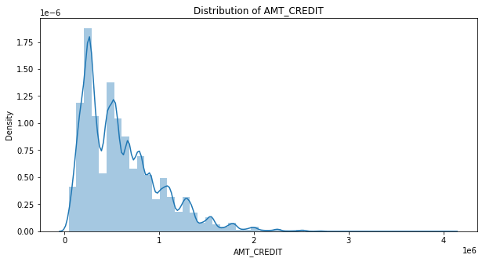
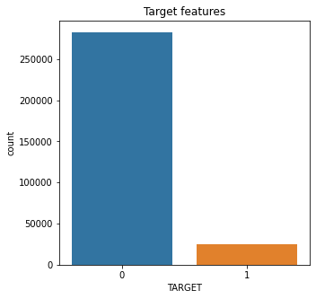
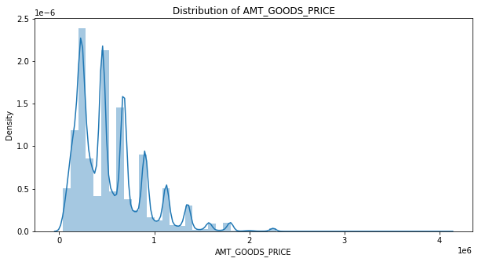
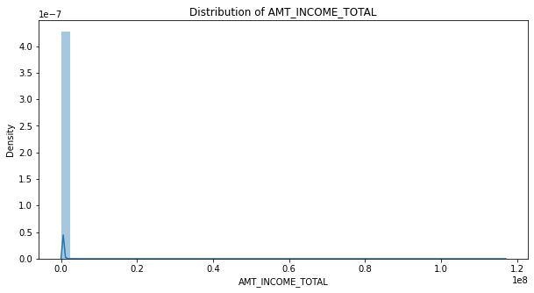
Distribution Data

Slide 5
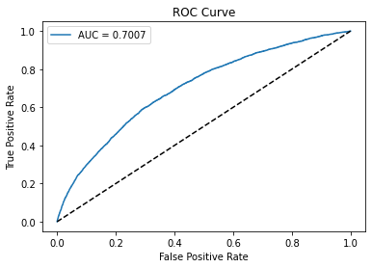
Logistic Regression
Validation ROC AUC: 0.7007499769555399

Slide 6
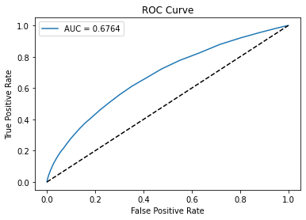
Random Forest
Validation ROC AUC: 0.6763926451636325

Slide 7
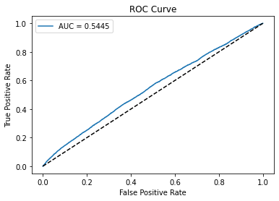
Support Vector Machine
Validation ROC AUC: 0.5444655474132954

Slide 8
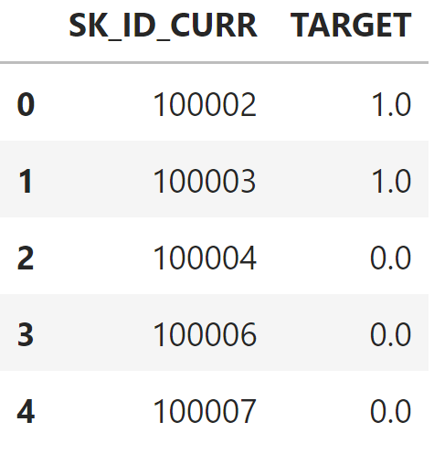
Submission Result
Model klasifikasi terbaik adalah Model Logistic Regression dengan nilai AUC: 0.7007
Dari Model Logistic Regression, dilakukan prediksi target berdasarkan SK_ID_CURR. Didapatkan hasil prediksi seperti pada gambar berikut dengan menampilkan 5 data teratas.
Repository codingan dapat dilihat pada link berikut: https://github.com/vanadri/credit_score/

